Slide 1
Bridge Scour Repair Workshop 2.0 Design Considerations
<?xml version="1.0"?><AllQuestions />
<?xml version="1.0"?><AllResponses />
<?xml version="1.0"?><Settings><answerBulletFormat>Numeric</answerBulletFormat><answerNowAutoInsert>No</answerNowAutoInsert><answerNowStyle>Explosion</answerNowStyle><answerNowText>Answer Now</answerNowText><chartColors>Use PowerPoint Color Scheme</chartColors><chartType>Horizontal</chartType><correctAnswerIndicator>Checkmark</correctAnswerIndicator><countdownAutoInsert>No</countdownAutoInsert><countdownSeconds>10</countdownSeconds><countdownSound>TicToc.wav</countdownSound><countdownStyle>Box</countdownStyle><gridAutoInsert>No</gridAutoInsert><gridFillStyle>Answered</gridFillStyle><gridFillColor>255,255,0</gridFillColor><gridOpacity>50%</gridOpacity><gridTextStyle>Keypad #</gridTextStyle><inputSource>Response Devices</inputSource><multipleResponseDivisor># of Responses</multipleResponseDivisor><participantsLeaderBoard>5</participantsLeaderBoard><percentageDecimalPlaces>0</percentageDecimalPlaces><responseCounterAutoInsert>No</responseCounterAutoInsert><responseCounterStyle>Oval</responseCounterStyle><responseCounterDisplayValue># of Votes Received</responseCounterDisplayValue><insertObjectUsingColor>Red</insertObjectUsingColor><showResults>Yes</showResults><teamColors>Use PowerPoint Color Scheme</teamColors><teamIdentificationType>None</teamIdentificationType><teamScoringType>Voting pads only</teamScoringType><teamScoringDecimalPlaces>1</teamScoringDecimalPlaces><teamIdentificationItem></teamIdentificationItem><teamsLeaderBoard>5</teamsLeaderBoard><teamName1></teamName1><teamName2></teamName2><teamName3></teamName3><teamName4></teamName4><teamName5></teamName5><teamName6></teamName6><teamName7></teamName7><teamName8></teamName8><teamName9></teamName9><teamName10></teamName10><showControlBar>All Slides</showControlBar><defaultCorrectPointValue>0</defaultCorrectPointValue><defaultIncorrectPointValue>0</defaultIncorrectPointValue><chartColor1>187,224,227</chartColor1><chartColor2>51,51,153</chartColor2><chartColor3>0,153,153</chartColor3><chartColor4>153,204,0</chartColor4><chartColor5>128,128,128</chartColor5><chartColor6>0,0,0</chartColor6><chartColor7>0,102,204</chartColor7><chartColor8>204,204,255</chartColor8><chartColor9>255,0,0</chartColor9><chartColor10>255,255,0</chartColor10><teamColor1>187,224,227</teamColor1><teamColor2>51,51,153</teamColor2><teamColor3>0,153,153</teamColor3><teamColor4>153,204,0</teamColor4><teamColor5>128,128,128</teamColor5><teamColor6>0,0,0</teamColor6><teamColor7>0,102,204</teamColor7><teamColor8>204,204,255</teamColor8><teamColor9>255,0,0</teamColor9><teamColor10>255,255,0</teamColor10><displayAnswerImagesDuringVote>Yes</displayAnswerImagesDuringVote><displayAnswerImagesWithResponses>Yes</displayAnswerImagesWithResponses><displayAnswerTextDuringVote>Yes</displayAnswerTextDuringVote><displayAnswerTextWithResponses>Yes</displayAnswerTextWithResponses><questionSlideID></questionSlideID><controlBarState>Expanded</controlBarState><isGridColorKnownColor>True</isGridColorKnownColor><gridColorName>Yellow</gridColorName></Settings>
<?xml version="1.0"?><AllAnswers />
Session Facilitator: Jim Bakken
This presentation was prepared by Ayres Associates engineers and is part of National Highway Institute coursework.

Slide 2
Bridge Scour
1. Inspection
2. Countermeasure Selection

Slide 3
COMPREHENSIVE METHODOLOGY
HEC-20
HEC-18
HEC-23
Notes:
HEC 20 Stream Stability at Highway Structures (Understanding Stream Behavior)
HEC 18 Evaluating Scour at Bridges (Scour Calculations)
HEC 23 Bridge Scour and Stream Instability Countermeasures (Selecting and designing countermeasures)

Slide 4
1. Bridge Scour Inspection
Stream Instability
Scour Components
Notes:
Stream stability includes degradation, aggradation and stream migration.
Scour components include contraction scour and local scour (pier and abutment)

Slide 5
LONG-TERM DEGRADATION
What factors cause change?
Notes:
Any activity that disrupts water/sediment equilibrium can cause degradation
Urbanization – typically more water running off, less sediment delivered as a result of paving
Dams – act as sediment traps
Sand and gravel mining

Slide 6
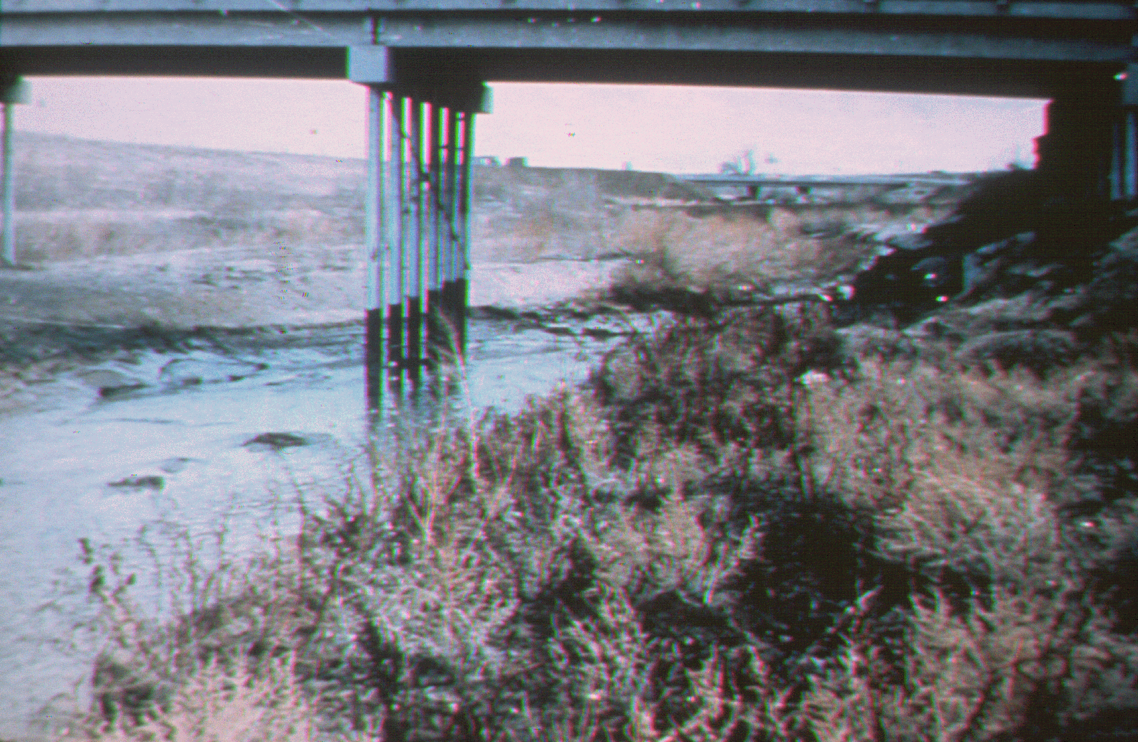
CHANNEL DEGRADATION
Notes:
Example of stream degradation

Slide 7
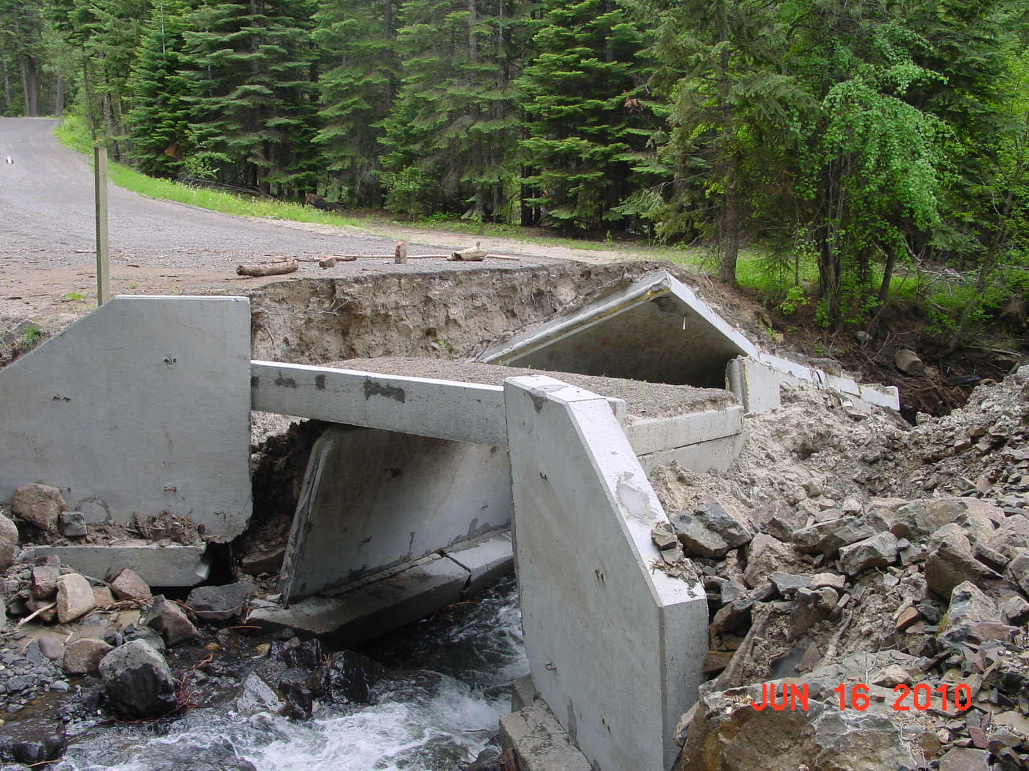
CHANNEL DEGRADATION AND LOCAL SCOUR
Notes:
Example of stream degradation and contraction scour of bridge with shallow spread footings. Location unknown.

Slide 8
ESTIMATING LONG-TERM CHANGE
Bridge inspection records
Geology and stream morphology
Notes:
Bridge inspection records are an excellent source of stream degradation.
Trends can be observed by reviewing inspection records and stream cross sections.
USGS sometimes will have a stream gage nearby where stream gaging records may suggest long term degradation or lateral migration.

Slide 9
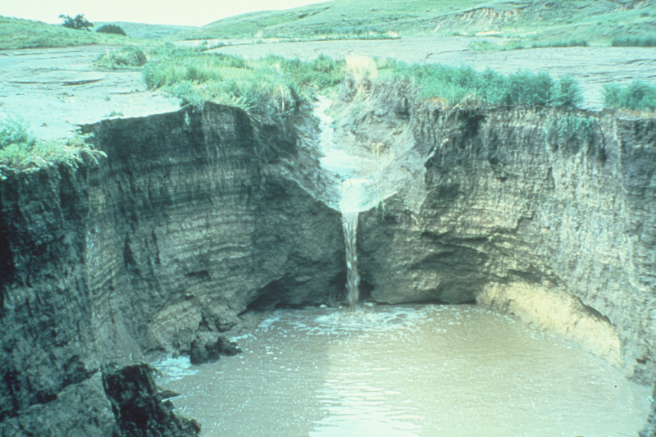
CHANNEL INSTABILITY (HEAD CUT)
Notes:
Geomorphology changes. This photo is a photo of a classic headcut in non-cohesive soils. Headcut could proceed upstream to threaten a bridge. In sandy soil, the stream degradation may be more gradual and be called a “nick.”

Slide 10
AGGRADATION
What factors cause change?
Notes:
Forest fires could result in additional sediment load to the stream and consequential aggradation in the stream. Extensive logging of the forest may also produce the same results.
Sediment delivery to the system increases.

Slide 11
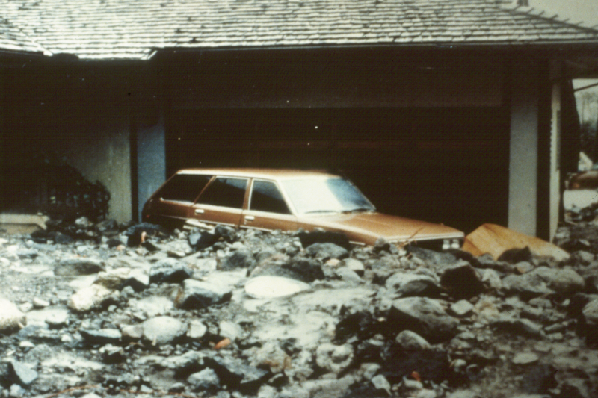
AGGRADATION
Notes:
Extreme aggradation as a result of a landslide and material transport during high flows.

Slide 12
CONTRACTION SCOUR
General lowering across bridge opening
May not be uniform in depth
Scour may be cyclic

Slide 13
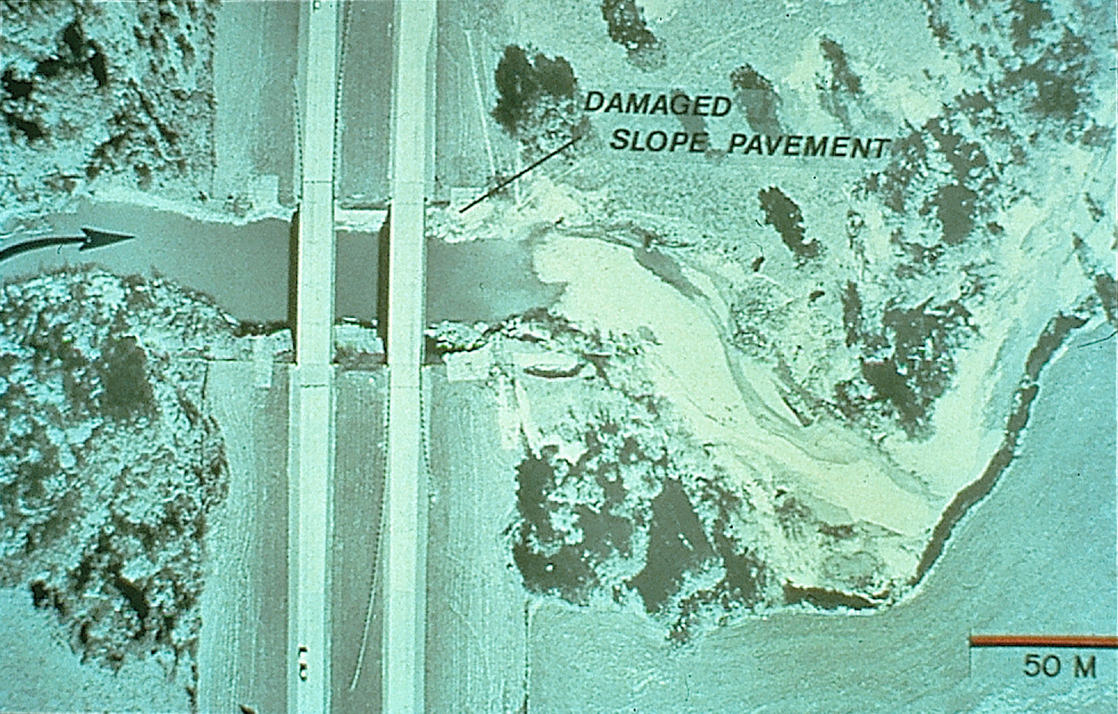
Notes:
Beaver Creek, Louisiana
Contraction Scour showing hole under the divided highway (piers cannot be seen) and damage to the slope pavement.
Sand from the scour hole was deposited downstream as can be seen in the photo.

Slide 14
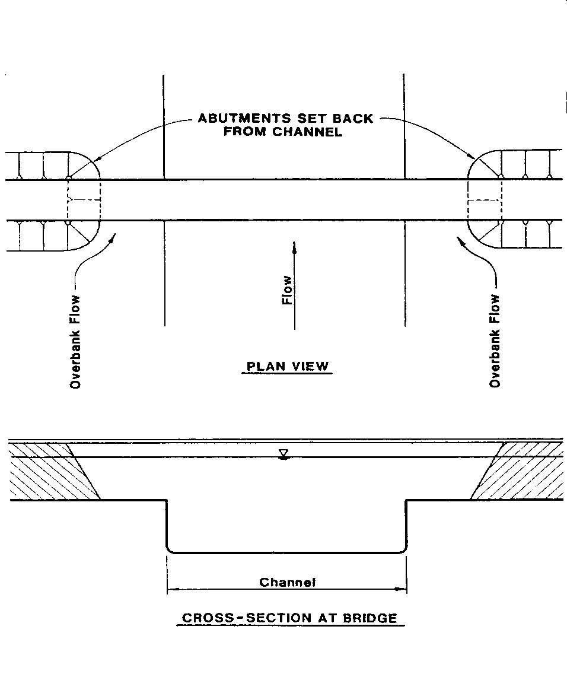
CONTRACTION SCOUR (ABUTMENT SET BACK FROM CHANNEL)
Notes:
In the case of abutments set back from the main channel, during floods the water flows outside the main channel and has to contract to get through the bridge.

Slide 15
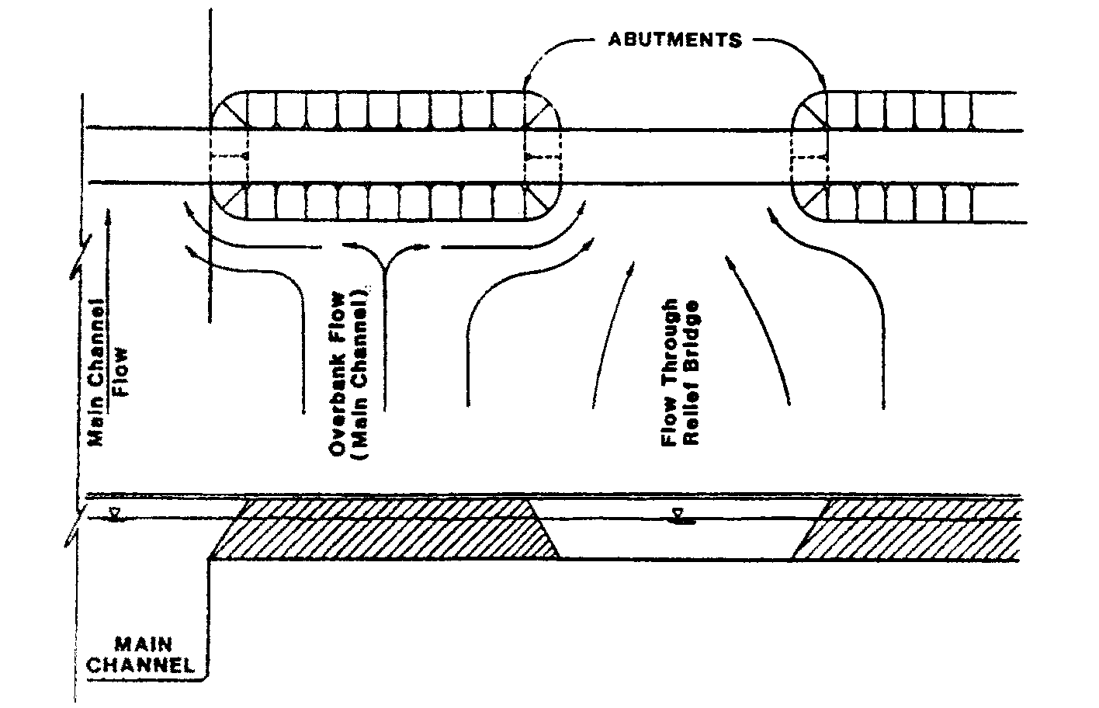
CONTRACTION SCOUR (RELIEF BRIDGE OVER FLOODPLAIN)
Notes:
Scour can be significant at relief bridges as well as the main channel bridge.

Slide 16
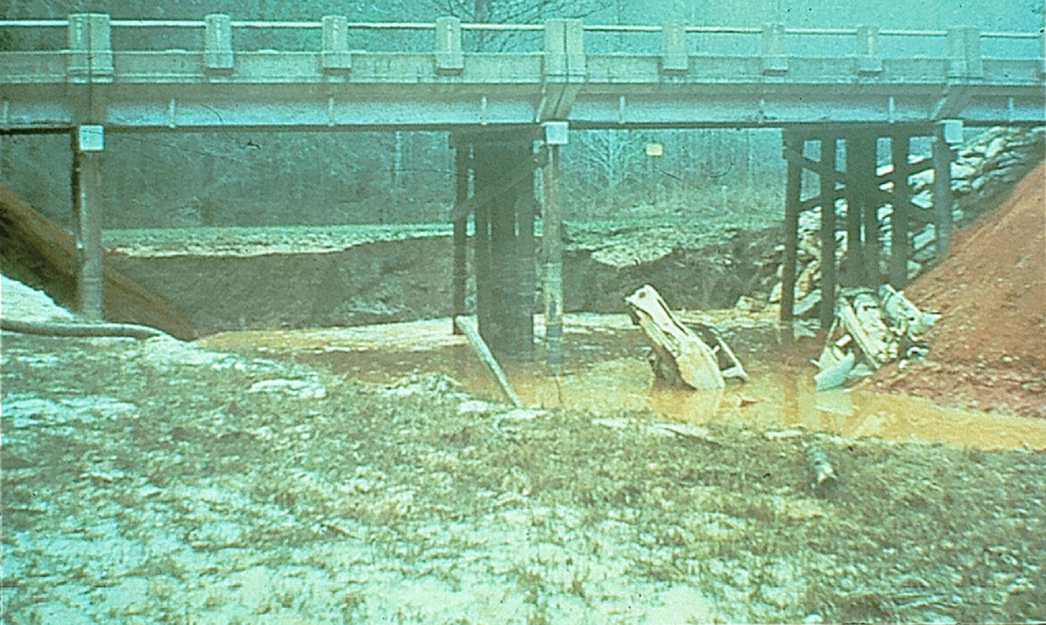
CONTRACTION SCOUR
Notes:
This photo shows a relief bridge on the Tom Bigby River in Mississippi. The scour hole formed during high flows and did not refill as the flood levels receded. The cars you see in the photo are “Detroit Riprap.”

Slide 17
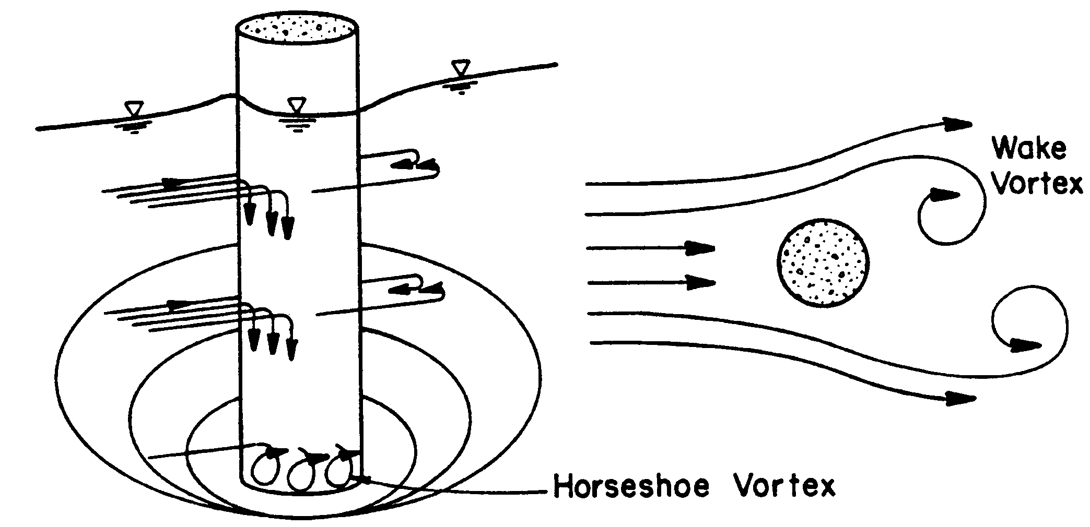
LOCAL SCOUR AT PIERS
Notes:
Note the direction of the currents on all sides of bridge piers. Scour will continue until an equilibrium is reached.
Note the horseshoe vortex at the toe of the pier. This is referred to by some as the “vacuum cleaner” vortex.
Currents work in concert to create the scour hole.

Slide 18
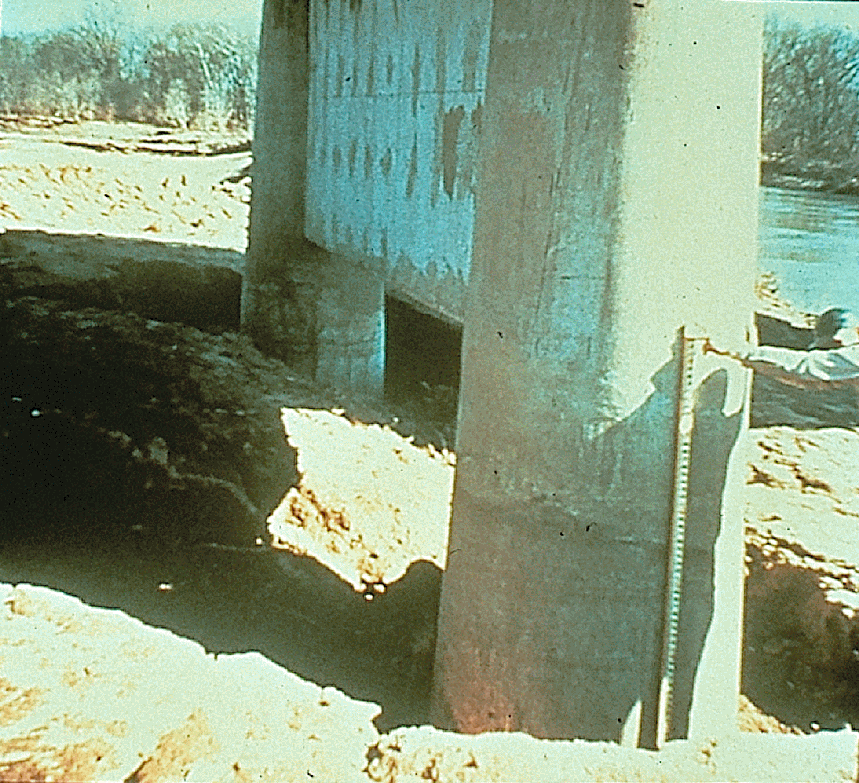
Notes:
Example of local pier scour. These piers were under water during the flood, but are now dry since the flood waters receded.

Slide 19
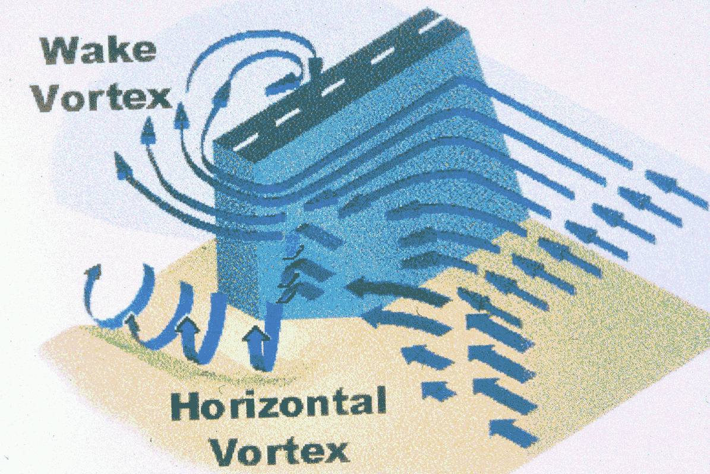
LOCAL SCOUR AT ABUTMENTS
Notes:
Note the vortexes around the abutment. The wake vortex and the horizontal vortex are the main causes of abutment scour.

Slide 20
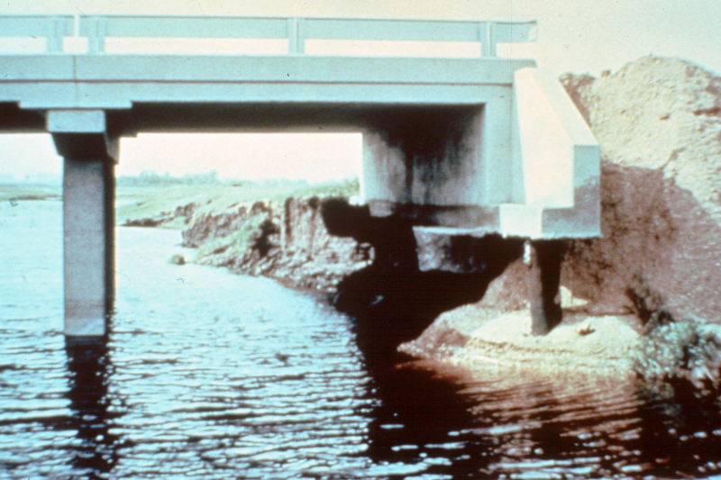
Notes:
Example of abutment scour.
Flow is coming toward the viewer.

Slide 21
EVALUATING SCOUR AT BRIDGES
Technical Advisory T 5140.23
http://www.fhwa.dot.gov/engineering/hydraulics/policymemo/t514023.cfm
Notes:
Technical Advisory T 5140.23 came out in 1991.
It is still valid and addresses bridge scour in general; the following slides highlight some of the guidance.

Slide 22
SCOUR EVALUATIONS
Bridge inspectors should receive training and instruction in inspecting bridges for scour
Results of evaluation coded in Item 113
A Plan of Action (POA) shall be developed and implemented for scour critical bridges

Slide 23
BRIDGE INSPECTORS
Should accurately record the present condition of the bridge, including cross section measurements

Slide 24
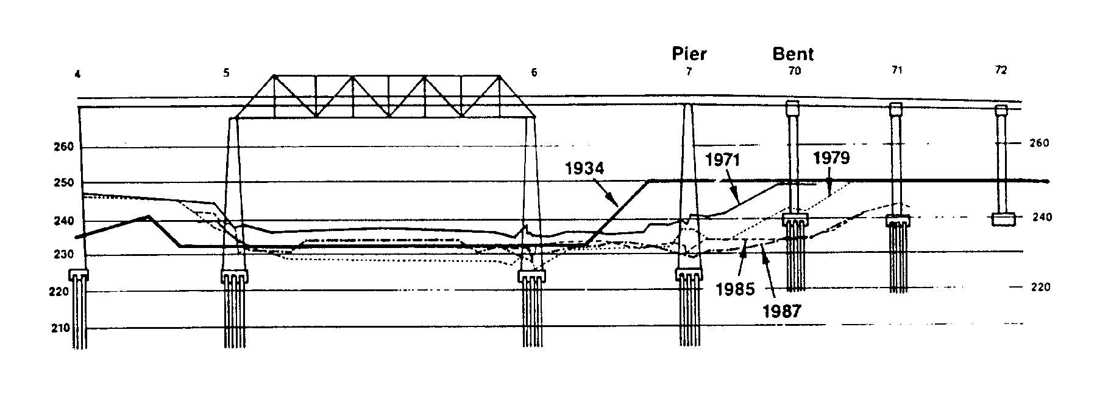
HATCHIE RIVER CHANNEL MIGRATION
Notes:
Hatchie River Bridge in Tennessee failed in 1989.
Stream instability resulted in migration of the channel, exposing bent 70.
Bent 70 was not designed to be in the channel and as a result failed after several years of stream migration exposed the piling.

Slide 25
BRIDGE INSPECTORS
Should identify conditions indicative of potential problems with stream instability and scour
Effective notification procedures should be available to permit proper communication of scour findings
Notes:
Bridge inspectors should be trained in how scour occurs so they can accurately assess the stream and bridge for indications of scour.
There should be a procedure to evaluate inspection results and initiate further investigation if warranted.

Slide 26
2. Bridge Scour Countermeasures
A countermeasure controls, inhibits, changes, delays, or minimizes stream instability and scour problems
Monitoring is considered a countermeasure but does not fix the problem
Notes:
Monitoring is considered to protect the safety of the traveling public through early warning of a problem and giving an opportunity to take action through temporary measures or even closing the bridge.

Slide 27
BRIDGE SCOUR General Categories
Long-term degradation
Contraction scour
Local scour
Notes:
Following slides will demonstrate these processes.

Slide 28
COUNTERMEASURES FOR DEGRADATION
Check dams
Drop Structures
Notes:
Check dams or drop structures stabilize the stream thalweg so that degradation is halted or controlled.
Continued degradation of the stream bottom will eventually threaten bridge piers and abutments.

Slide 29
COUNTERMEASURES FOR CONTRACTION SCOUR
Increase bridge opening
Decrease discharge through bridge opening by adding a relief bridge
Improve alignment of flow
Notes:
By increasing the bridge opening, velocities are reduced, lowering the potential for contraction scour.
Relief bridges will lower design flows through the main bridge opening, thereby reducing velocities and potential scour.
At times, bridges may not be aligned with the vector of stream flow. May have been a result of improper design alignment, or the stream may have migrated over the years. Improved alignment will reduce flow disturbances and vortex currents and hence lower the potential for scour.

Slide 30
ABUTMENT SCOUR COUNTERMEASURES
Guide banks
Revetments
Bulkheads
Riprap
Notes:
An example of guide bank performance is shown on the next slide.
These countermeasure selections will be discussed in subsequent slides.

Slide 31
Guide Bank
Scour Hole
Sand Deposit
Notes:
This is a Google Earth map of I-70 over the Missouri River near Rocheport, Missouri. The flood of 1993 was an extreme event. The river flows from top to bottom in the photo. There is a guide bank on the right abutment of the relief bridge. The flood scoured a 60 foot deep hole under and beneath the relief bridge. Sand from the scour hole was deposited downstream in the right overbank as seen as the light colored area in the air photo. The guide bank prevented severe damage or failure of the relief bridge.

Slide 32
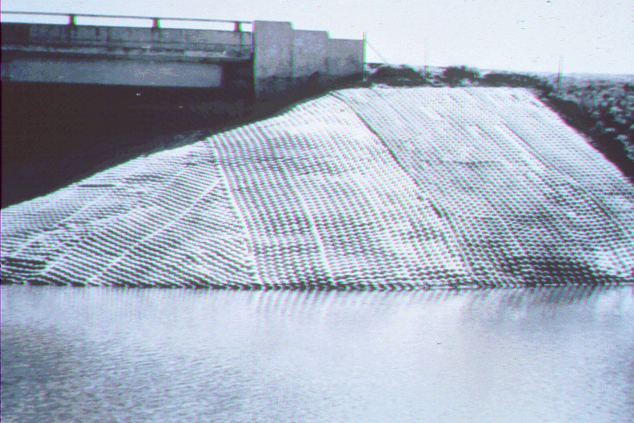
GROUT FILLED MATTRESS

Slide 33
COUNTERMEASURES FOR SCOUR AT PIERS
Streamline and align piers to flow
Increase spacing of piers and columns
Riprap is not recommended as a countermeasure for pier scour at new bridges
Riprap can be considered as a counter-measure to reduce the risk at existing bridges, but only with monitoring after high flows

Slide 34
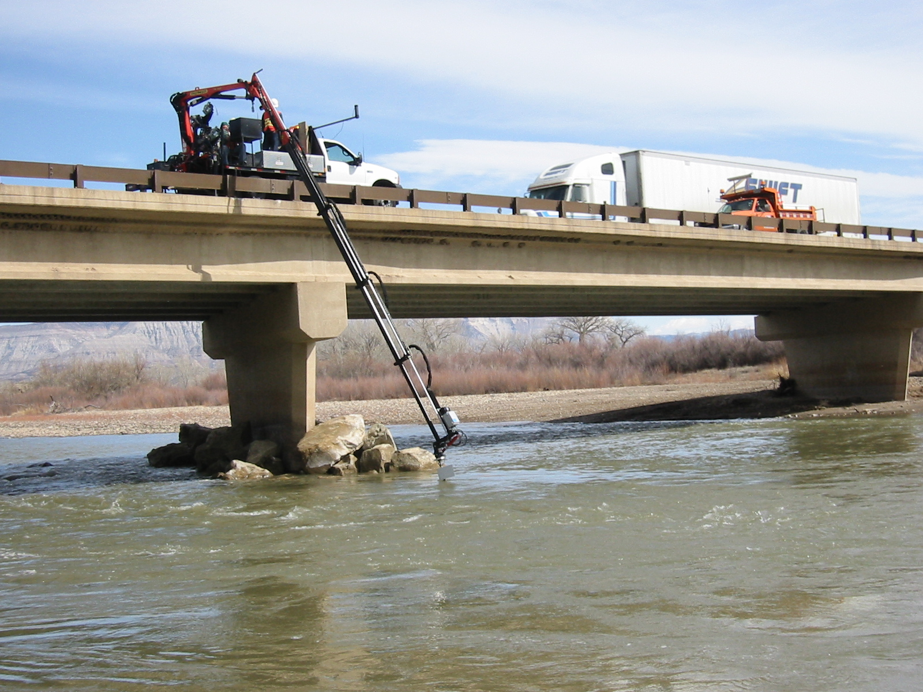
Notes:
Photo of monitoring of temporary riprap protection at a pier. Flow is going from left to right. The pier to the right in the photo is on the inside of the bend. The bridge is at Grand Junction, CO.

Slide 35
MONITORING
Fixed instruments
Portable instruments
Inspection

Slide 36
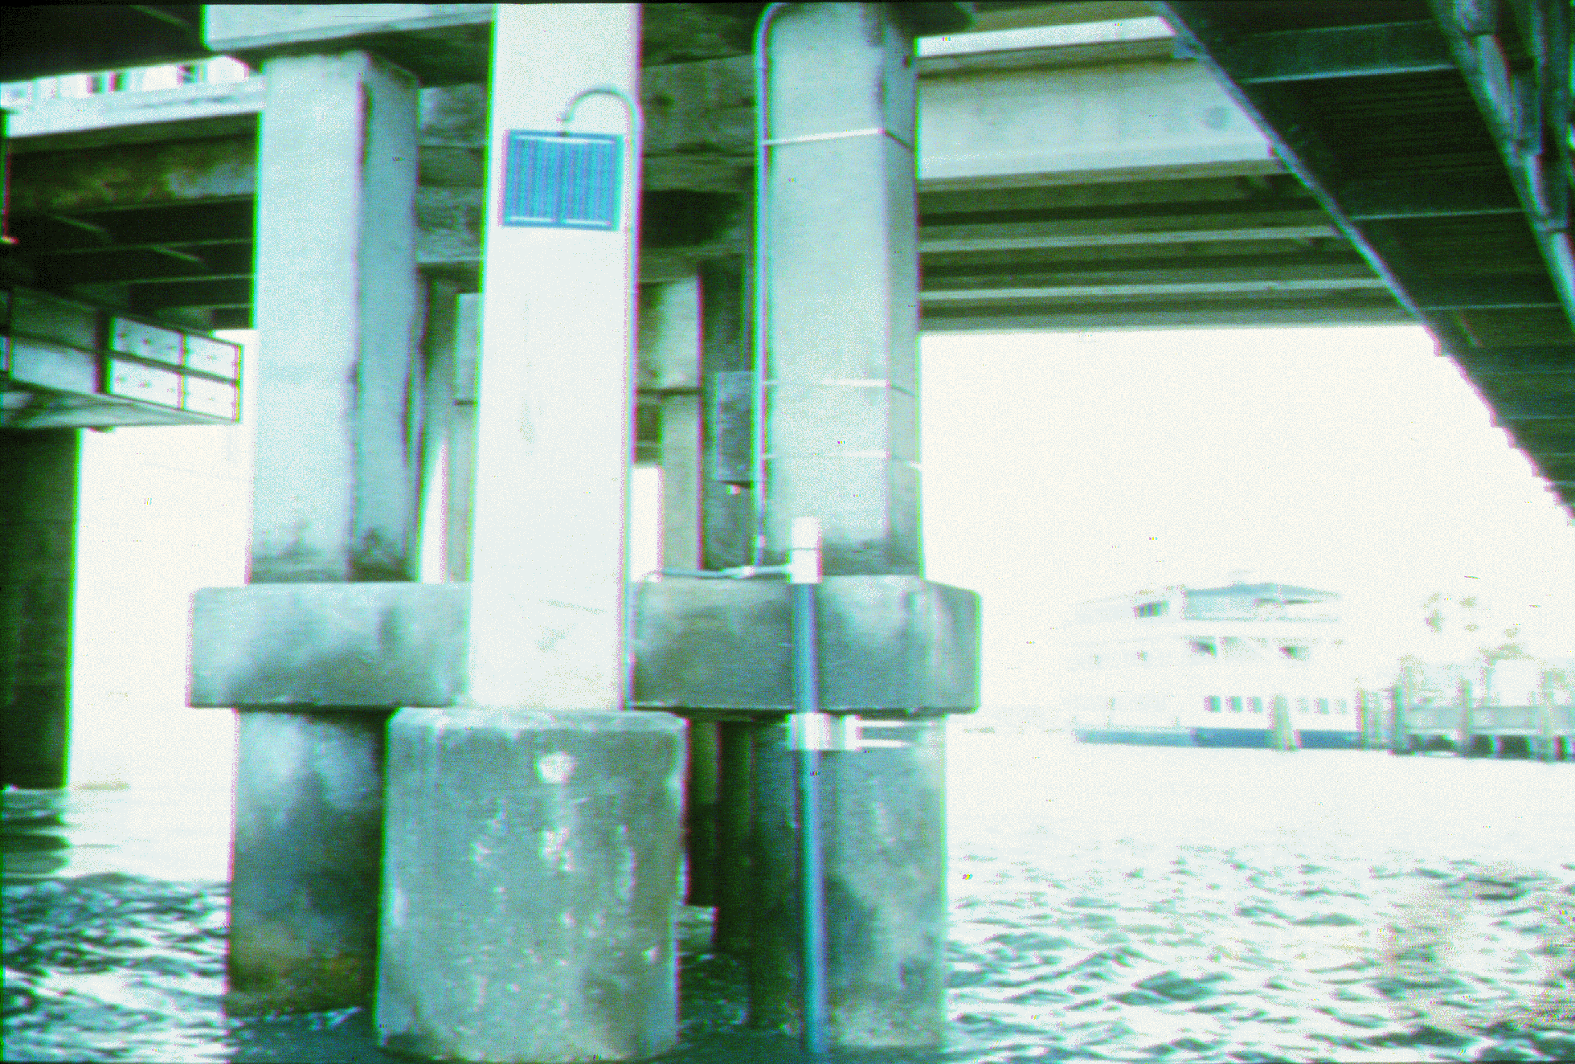

Slide 37
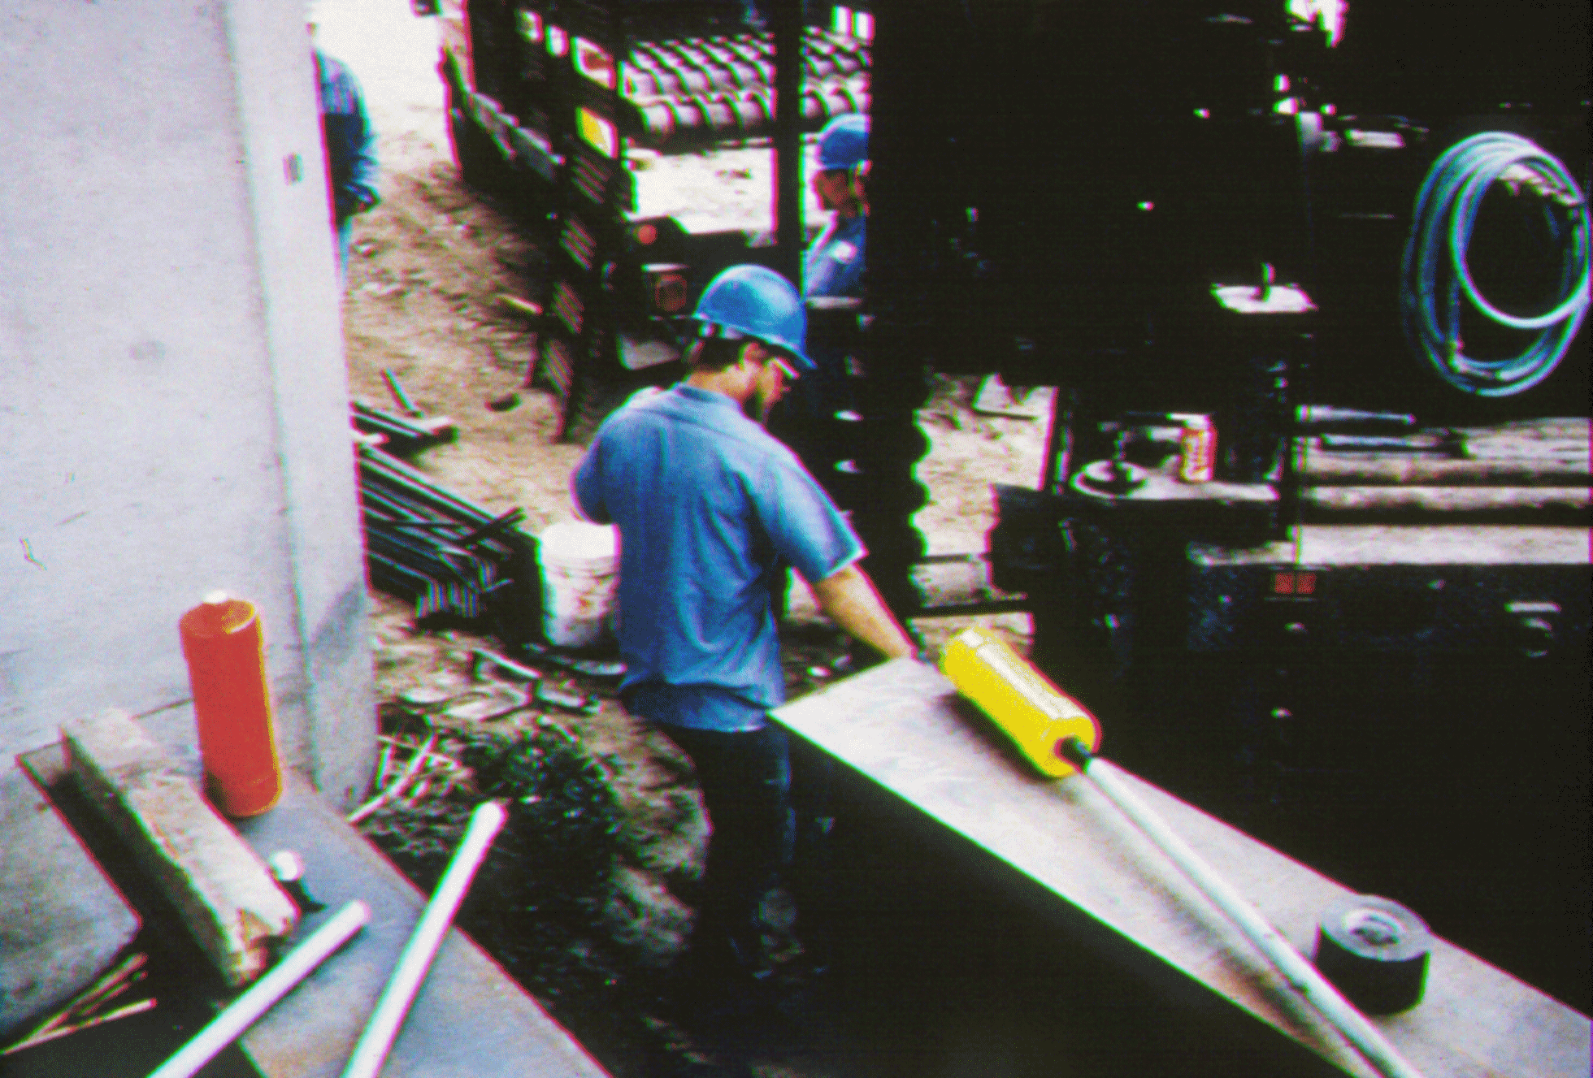
Notes:
Driller is installing “float-out” devices. These devices have a battery operated radio inside that will signal movement if scour reaches its depth and tips over activating a mercury switch. It sends a signal to a receiver mounted on the bridge superstructure. This site is on the Salinas River in California. One transmitter was placed at the 15 ft depth and the other at the 20 ft depth. During a subsequent flood, the 15 ft deep transmitter was scoured out, but the 20 ft deep transmitter remained in place.

Slide 38
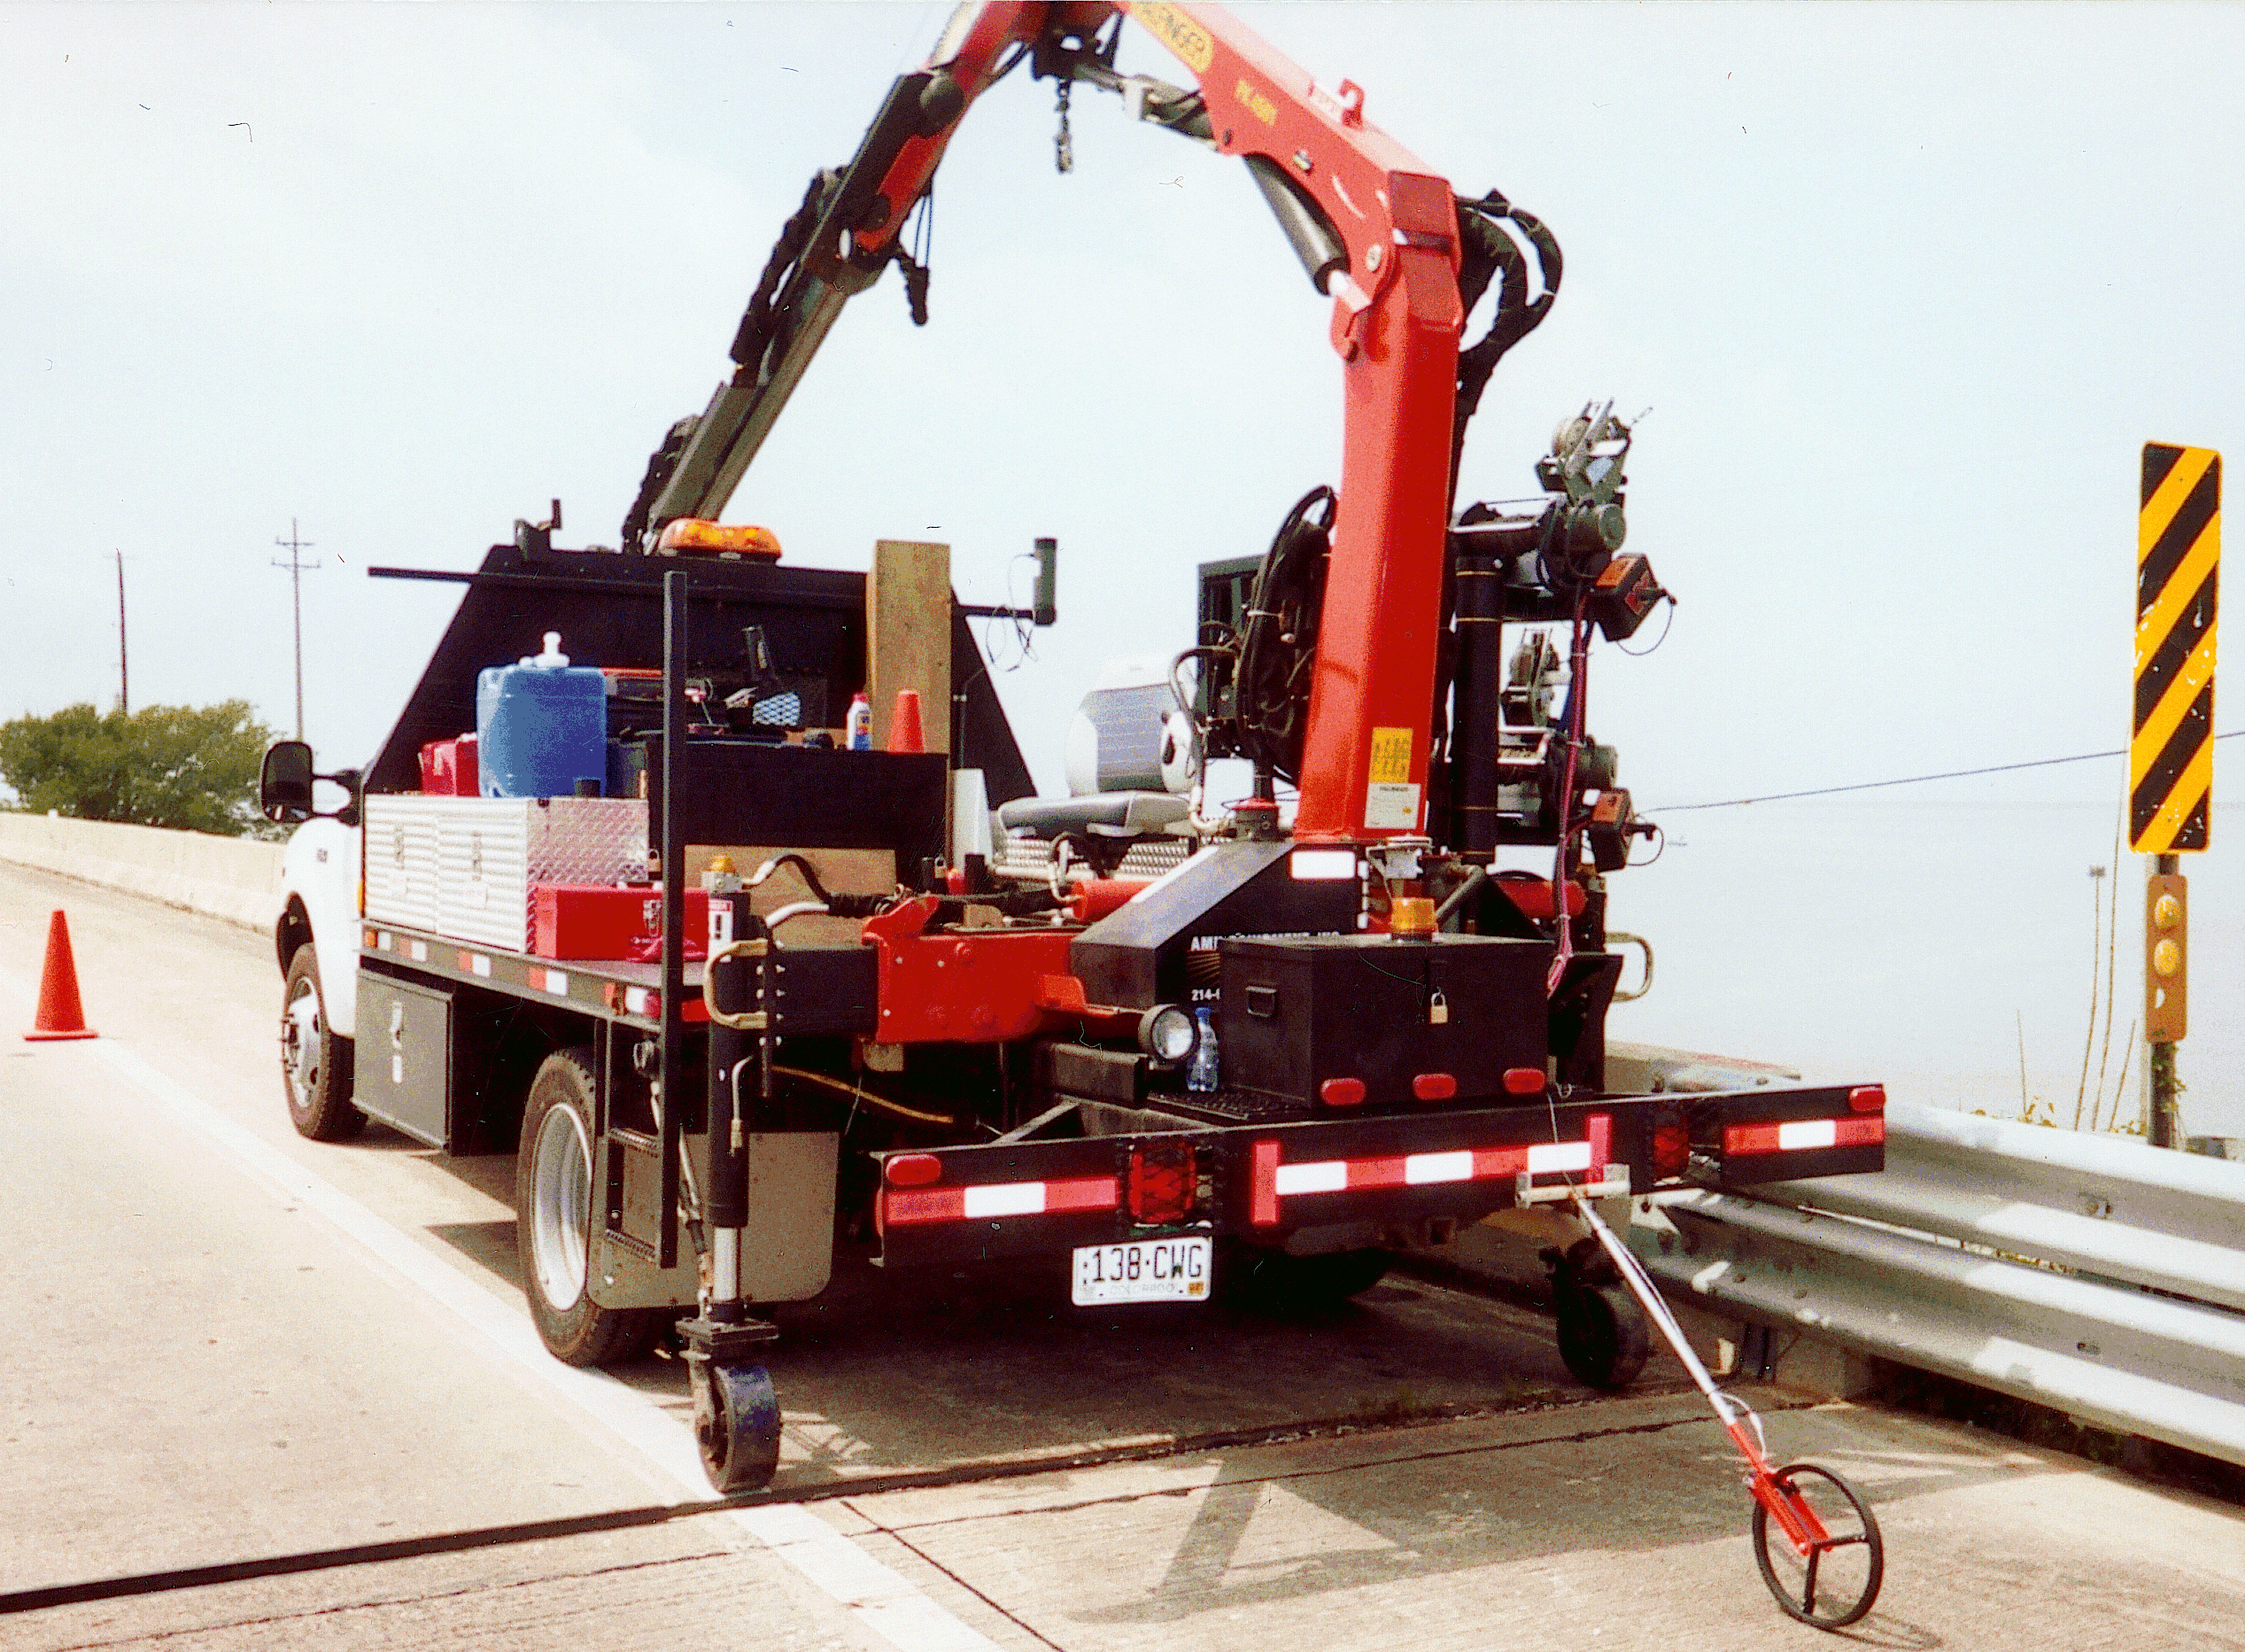
Notes:
Portable truck-mounted scour sensor in action. Wheel on back of the truck measures distance to provide horizontal control. A depth sounder is mounted on the end of the boom.

Slide 39
Selection of Countermeasures
Identify stream instability and scour countermeasures implemented by various DOTs
Provide a matrix which summarizes countermeasure application throughout the US.
Provide guidance for selecting countermeasures for a Plan of Action

Slide 40
THE COUNTERMEASURES MATRIX
Countermeasure Groups
Functional Applications
Suitable River Environment
Maintenance
Installation Experience by State
Design Guideline References
Notes:
Refer to the matrix handout, and describe generally the information on the matrix. The Matrix is in HEC-23 and is a handy reference. Point out the “consumers reports circles, dots, and half moons.

Slide 41
Scour Countermeasures
Given a stream stability and/or bridge scour problem, select appropriate countermeasures to correct the problem(s) considering functional applications and river characteristics

Slide 42
PIER SCOUR COUNTERMEASURE SELECTION SUPPORT SYSTEM
Notes:
Report 593 provides additional guidance that incorporates constructibility by way of a decision tree.

Slide 43
PIER SCOUR COUNTERMEASURE
SELECTION SUPPORT SYSTEM
SI = (S1 × S2 × S3 × S4)/LCC
Where:
SI = SELECTION INDEX
S1 = Bed Material Factor
S2 = Ice/Debris Loading Factor
S3 = Constructability Factor
S4 = Inspection/Maintenance Factor
LCC = Life-Cycle Cost
(Appendix B in NCHRP Report 593)
Notes:
The selection index is a function of the four factors S1-S4, and the life cycle cost.

Slide 44
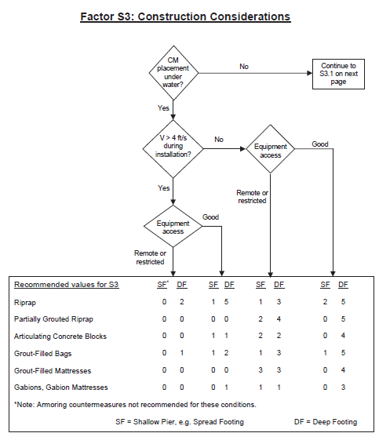
Notes:
Point out that there is an initial decision on above or below water installation. Then velocity and finally accessibility. Note that there are two columns for Shallow Footing, or Deep Footing.

Slide 45
Review
Bridge Scour Inspection
Scour Components
Inspection Documentation
Countermeasure Selection
Stream Stability
Suitability
Monitoring

